Slide 1

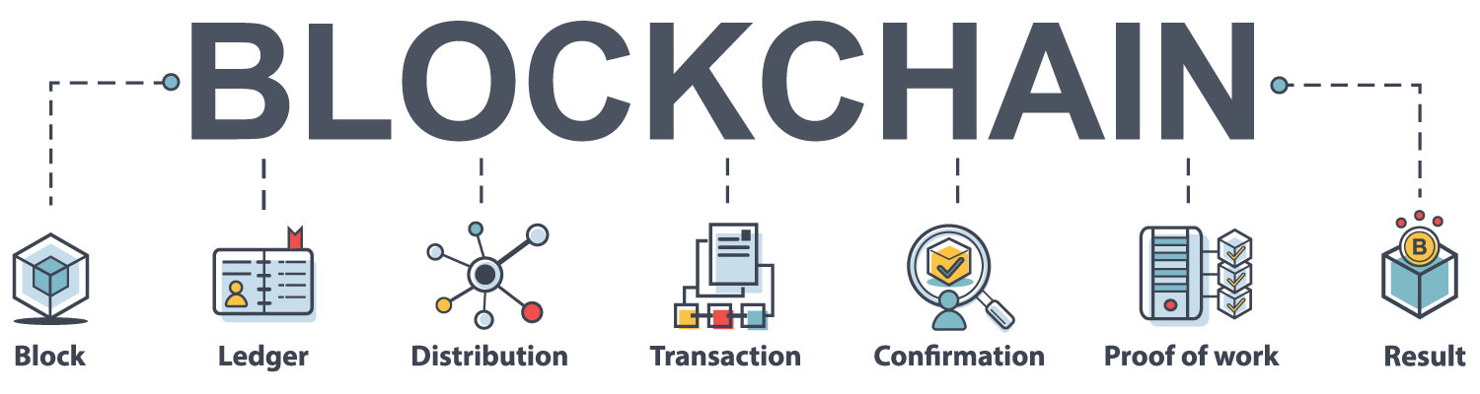
Cryptography
BITS F463
Blockchain for electronic voting system
GROUP NUMBER - 36 (G36)
Pranay Dasoju – 2019A7PS0006H
Prabhat Mutyala – 2019A4PS1331H
Raja Vardhan – 2019A7PS1337H

Slide 2
Abstract:
Electoral integrity is essential not just for democratic nations but also for state voter’s trust and liability.
The traditional or paper-based polling method served to increase people’s confidence in the selection by majority voting.
Engineers across the globe have created new voting techniques that offer some anti corruption protection while still ensuring that the voting process should be correct.
Electronic voting increases election reliability when compared to manual polling. In contrast to the conventional voting method, it has enhanced both the efficiency and the integrity of the process.
Because of its flexibility, simplicity of use, and cheap cost compared to general elections, electronic voting is widely utilized in various decisions.

Slide 3
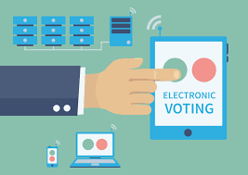
Drawbacks of current electronic voting systems:
Existing electronic voting methods run the danger of over-authority and manipulated details, limiting fundamental fairness, privacy, secrecy, anonymity, and transparency in the voting process.
Most procedures are now centralized, licensed by the critical authority, controlled, measured, and monitored in an electronic voting system, which is a problem for a transparent voting process in and of itself.
The electronic voting protocols have a single controller that oversees the whole voting process called the election commission.
There are other problems with existing systems including illegal voting, data protection and privacy, fairness.

Slide 4
Problems of Developing Online Voting Systems
Eligibility: Only legitimate voters should be able to take part in voting
Unreusability: Each voter can vote only once
Privacy: No one except the voter can obtain information about the voter’s choice
Fairness: No one can obtain intermediate voting results
Soundness: Invalid ballots should be detected and not taken into account during tallying
Completeness: All valid ballots should be tallied correctly

Slide 5
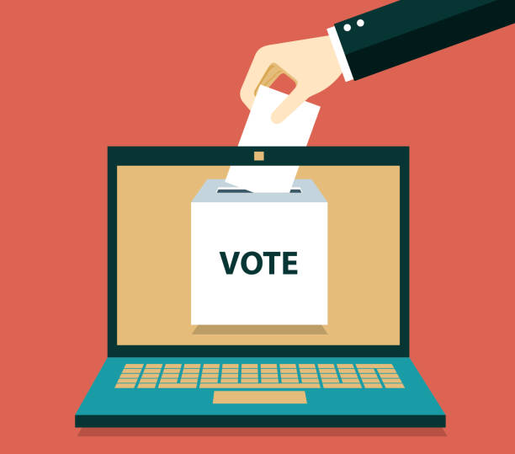
How Blockchain Can Transform the Electronic Voting System
Our project aims to solve some of the above problems using blockchain technology whereas the current solutions rely on a central authority.
The blockchain is digital, decentralized, encrypted and transparent ledger that can withstand manipulation and fraud.
Electronic voting based on blockchain will only work where the online voting system is fully controlled by no single body, not even the government.

Slide 6
Solving the issue of unreusability
Each vote cast by a voter is recorded in the blockchain. To protect the privacy of the voter, the voter’s identity and his/her choice is kept secret using encryption.
Each node in the network can count votes with absolute certainty, knowing that each ID can be attributed to one vote, no fakes can be created, and that tampering is impossible.
Due to encryption and decentralization, blockchain’s database of transactions is incorruptible, and each record is easily verifiable.

Slide 7
Solving the issue of soundness and completeness
Since we need to ensure that no one can obtain intermediate results and since we need to protect voter privacy, implementing soundness and completeness is not straightforward.
We need to prove that the encrypted data meets the properties of a valid ballot without compromising any information that can help determine how the vote was cast.
This task is solved using Zero Knowledge Proof (ZKP)
We use the Zero Knowledge Proof mentioned as part of the problem statement to detect invalid ballots and tally valid ballots without knowing about the voter’s identity or his/her choice and thus preserve soundness and completeness of the system.

Slide 8
Important functions that are implemented
createBlock()
All the votes casted and ready to be verified are collected using the createBlock() function and they will become part of the next block in the blockchain. Additional required header information such as the hash of the previous block, nounce, target, timestamp are added to the block in this function.
verifyTransaction()
After the block is created, the integrity of the each transaction i.e. the vote cast, will be verified using this function. This function makes sure that the voter ID is valid, the voter hasn’t casted a vote before and the candidate for whom the vote being cast is a valid candidate, for each transaction in the block.
mineBlock()
Proof of work for the blockchain. This will be similar to those used for cryptocurrencies by giving a financial incentive to the miner to add a new block to the ledger.
viewUser()
Lists all successful transactions by the user and other related information.

Slide 9
Thank you!

